Slide 1

Unity Editor + IDE

Slide 2
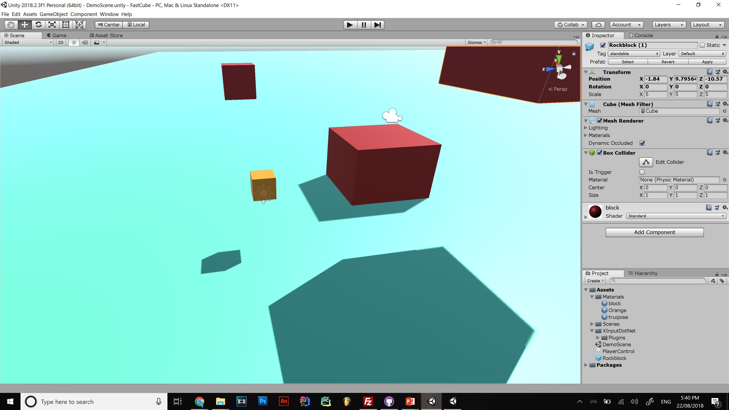

Game feel
Notes:
Assets folder is in the root of the project folder put all your stuff in there!!
Be organised and put scripts in Assets/Scripts , materials in Assets/Materials etc,,

Slide 3
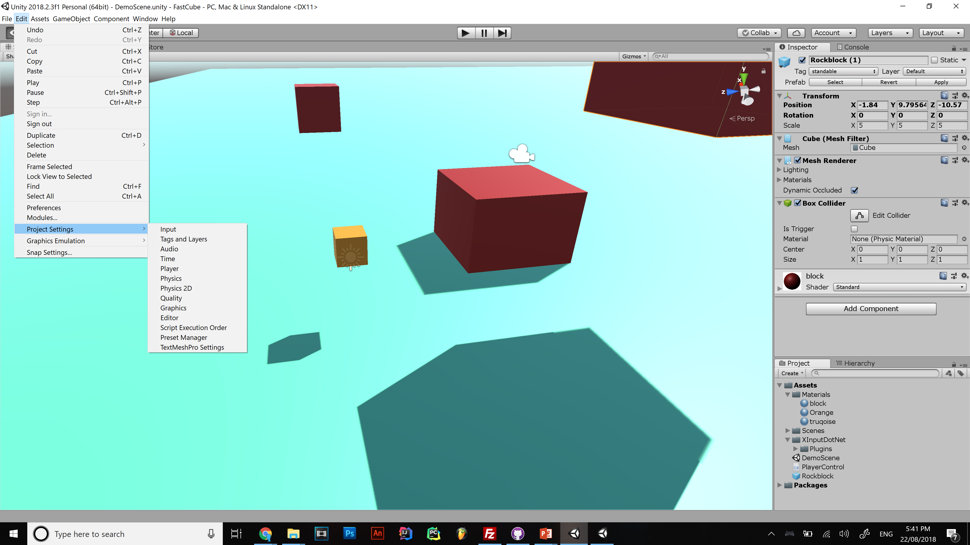

Slide 4
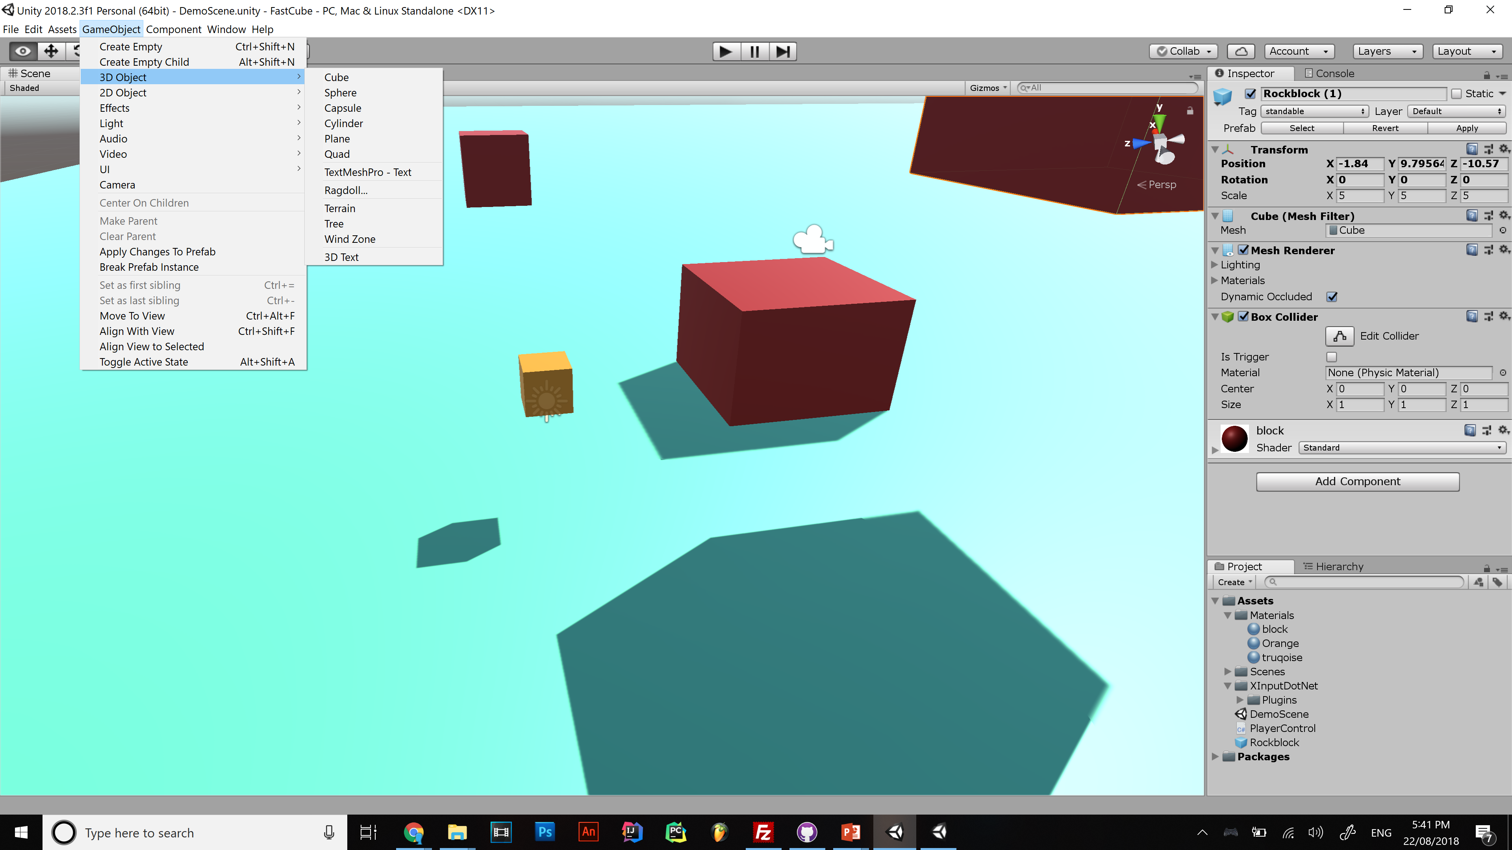

Slide 5
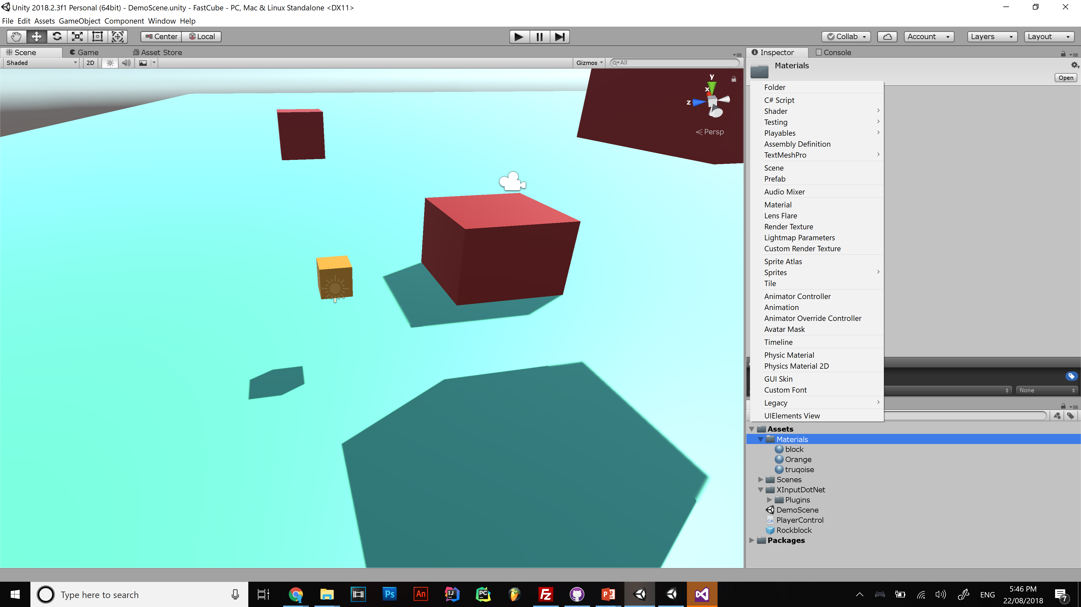

Slide 6
pause for breath

Slide 7
Unity organises games into scenes
Level 1
Main Menu
Level 2
Credits

Slide 8
Components

Slide 9
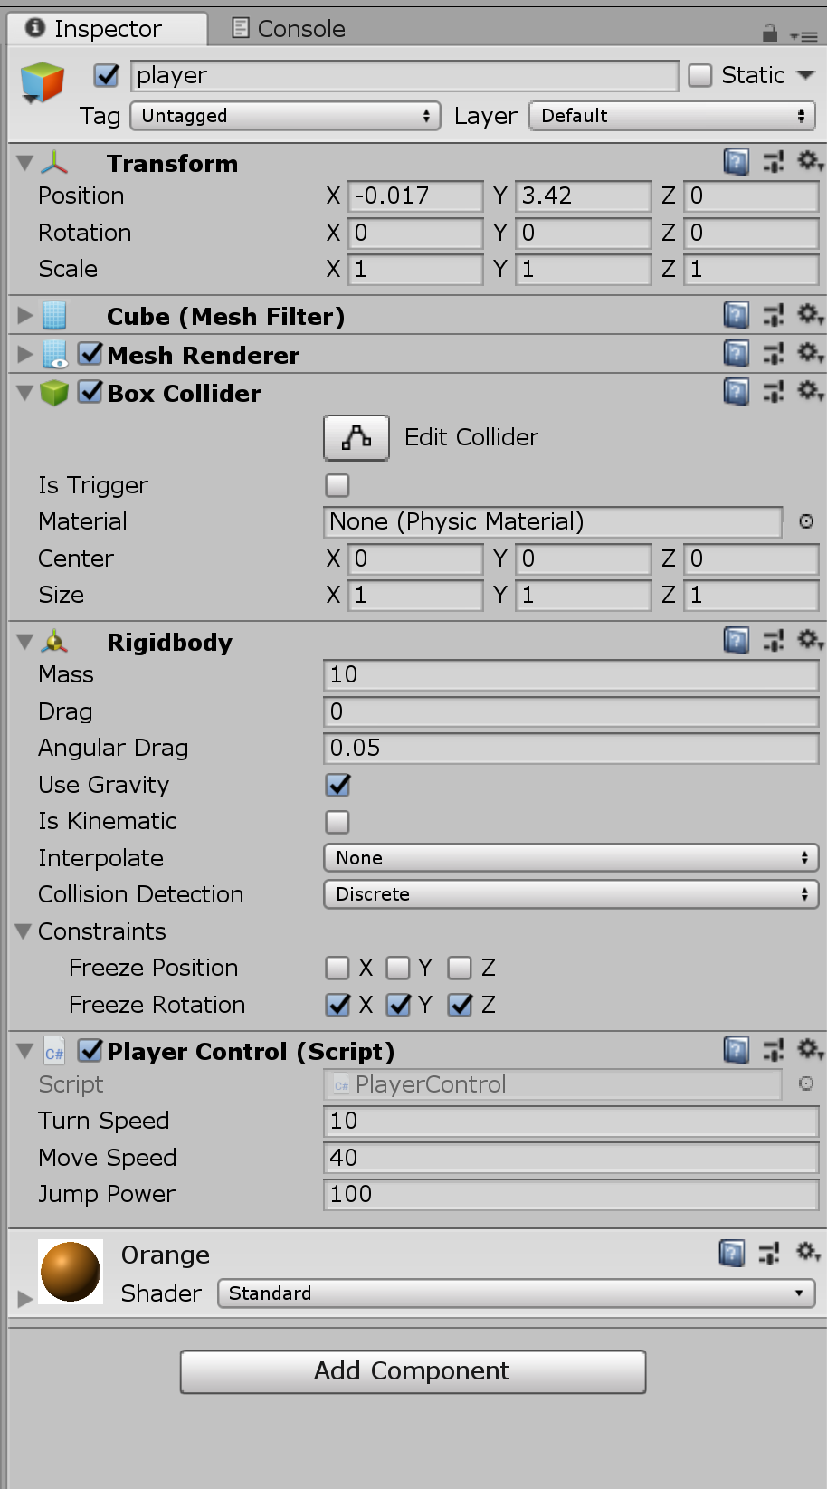
Unity is Game objects and engine settings
Game Objects
Transform
Mesh
Renderer
Components
Materials
Scripts
Physics
Collider/Hitbox
Animations
Audio
etc
Public variables

Slide 10
Separate your mechanics into your objects
Coin objects have a script that gives the player object one coin and disappears
Put menu controls on a object on the canvas
Player controls on player object

Slide 11
If you understand all that you’re ready to code
Kinda..
Now install visual studio
Which you can get for free because you are a student

Slide 12
I like visual studio but you can also use any IDE you like

Slide 13
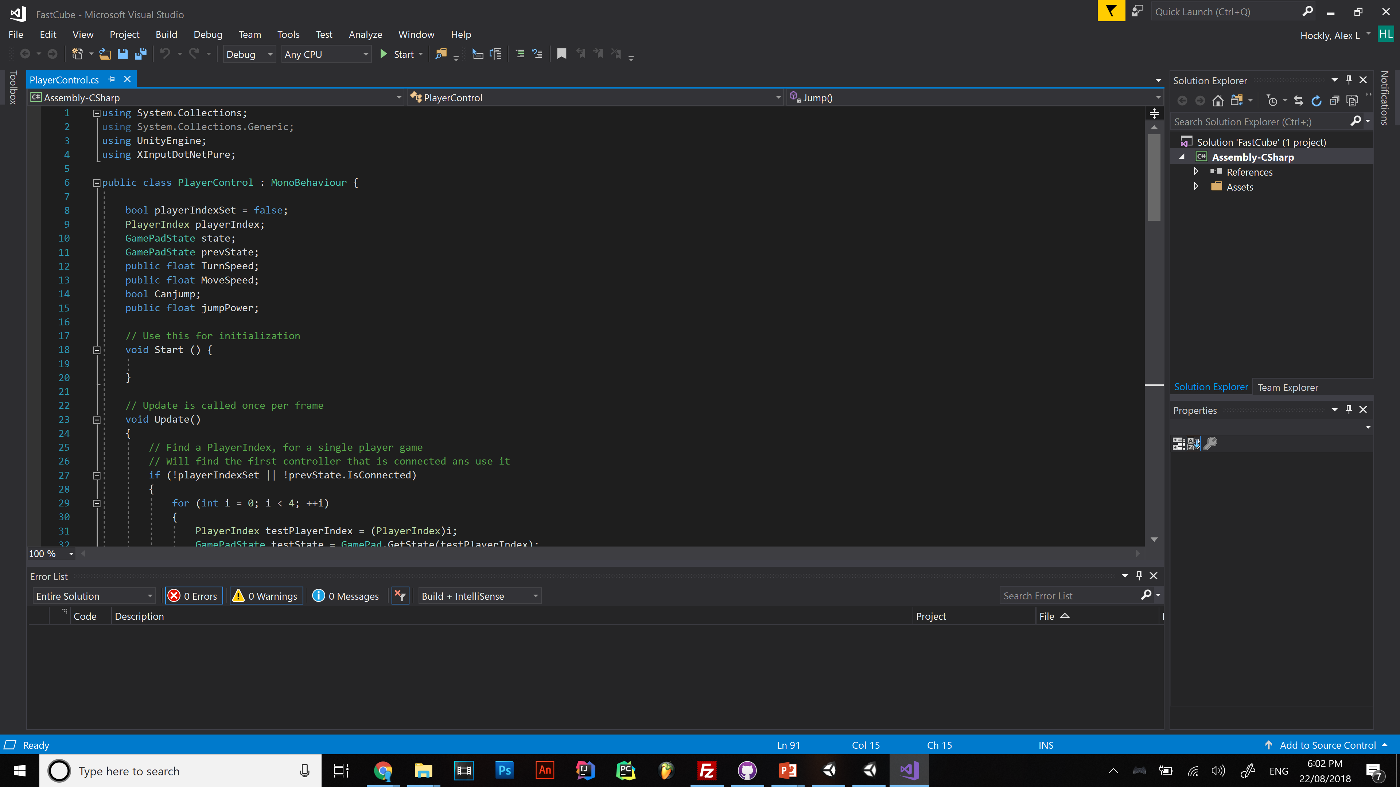
Notes:
UI breakdown

Slide 14
Look out for outdated info!! If a forum post is more than 3 years old avoid it

Slide 15
Unity documentation
https://docs.unity3d.com/ScriptReference/Transform.html

Slide 16
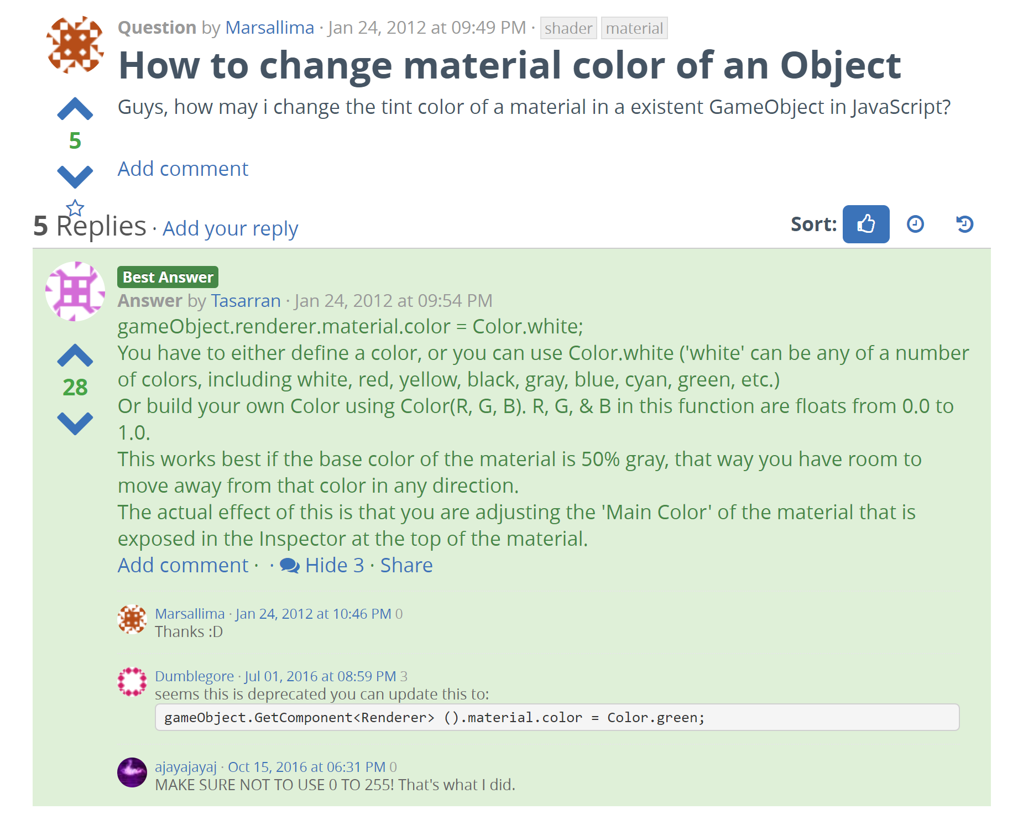
https://answers.unity.com/questions/209573/how-to-change-material-color-of-an-object.html

Slide 17
Code Flow
Continuous and real-time
Frame are made as fast as hardware allows
Update is called 120 times a second at 120fps and 30 time a second at 30fps
DO NOT put a infinite loop in the update function

Slide 18
Deconstructing Zenyatta’s attack

Slide 19
Deconstructing Zenyatta’s attack
Projectile (effect on collision)
Delay between attacks
You can hold the mouse down
Hitscan vs projectile

Slide 20
using System.Collections;
using System.Collections.Generic;
using UnityEngine;
public class PlayerControl : MonoBehaviour {
public float shootdist;
public float shootspeed;
public bool canAttack;
public float cooldown;
public GameObject orb;
int orbcount;
// Use this for initialization
void Start () {
orbcount = 0;
canAttack = true;
//orb = Resources.Load("orb") as GameObject;
}
// Update is called once per frame
void Update () {
if (Input.GetMouseButton(0) &&canAttack)
{
Attack();
}
}
void Attack() {
StartCoroutine(AttackCoolDown());
orbcount++;
GameObject orbclone = (GameObject)Instantiate(orb);
orbclone.name = "orb no."+orbcount.ToString();
orbclone.transform.position = transform.position + transform.forward * shootdist;
orbclone.GetComponent<Rigidbody>().velocity = transform.forward * shootspeed;
}
IEnumerator AttackCoolDown()
{
canAttack = false;
yield return new WaitForSecondsRealtime(cooldown);
canAttack = true;
}
}

Slide 21
public float shootdist;
public float shootspeed;
public bool canAttack;
public float cooldown;
public GameObject orb;
int orbcount;
void Start () {
orbcount = 0;
canAttack = true;
}
void Update () {
if (Input.GetMouseButton(0) &&canAttack)
{
Attack();
}
}

Slide 22
void Attack() {
StartCoroutine(AttackCoolDown());
orbcount++;
GameObject orbclone = (GameObject)Instantiate(orb);
orbclone.name = "orb no."+orbcount.ToString();
orbclone.transform.position = transform.position + transform.forward * shootdist;
orbclone.GetComponent<Rigidbody>().velocity = transform.forward * shootspeed;
}

Slide 23
Realtime things
IEnumerator AttackCoolDown()
{
canAttack = false;
yield return new WaitForSecondsRealtime(cooldown);
canAttack = true;
}

Slide 24
Variable types
Unity User-interface
Start() and Update()
GameObject – transform.position, Rigid Body
Coroutines

Slide 25
Some more unity concepts
Prefabs
Primitive geometry
Tags
.unityPackage

Slide 26
Unity quirks
Open the .unity file from file explorer

Slide 27
Next time
Vector3()?
UI?

